Slide 1
Closed Loop to Physiology (CLoSES-RT)
General Overview

Slide 2
Overview
This presentation aims to provide an overview of the CLoSES-RT platform
It is designed to detect and send stimulation in near-real time
In this way it is possible to stimulate during a physiological or pathological event of interest.

Slide 3
Types of Models
CLoSES-RT - Closed Loop to Physiology
Human Real Time (data from BlackRock NSP)
NHP Real Time (data from Plexon)
Simulations
CLoSES-SEM (Trial by Trial Neural Decoder Model)
Human Real Time
Simulations
Notes:
One PPT for each of these models will explain them in more detail
Each group use the same closed-loop model diagram. The only difference is the input.

Slide 4
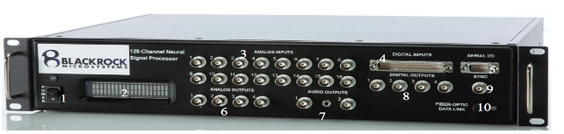
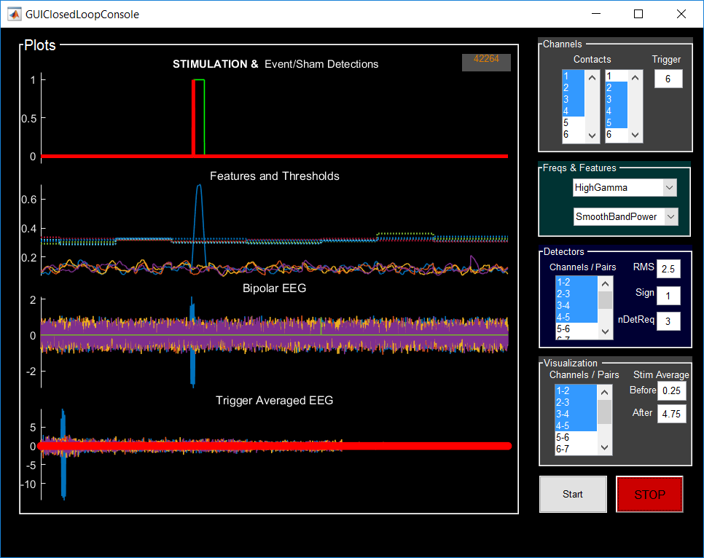
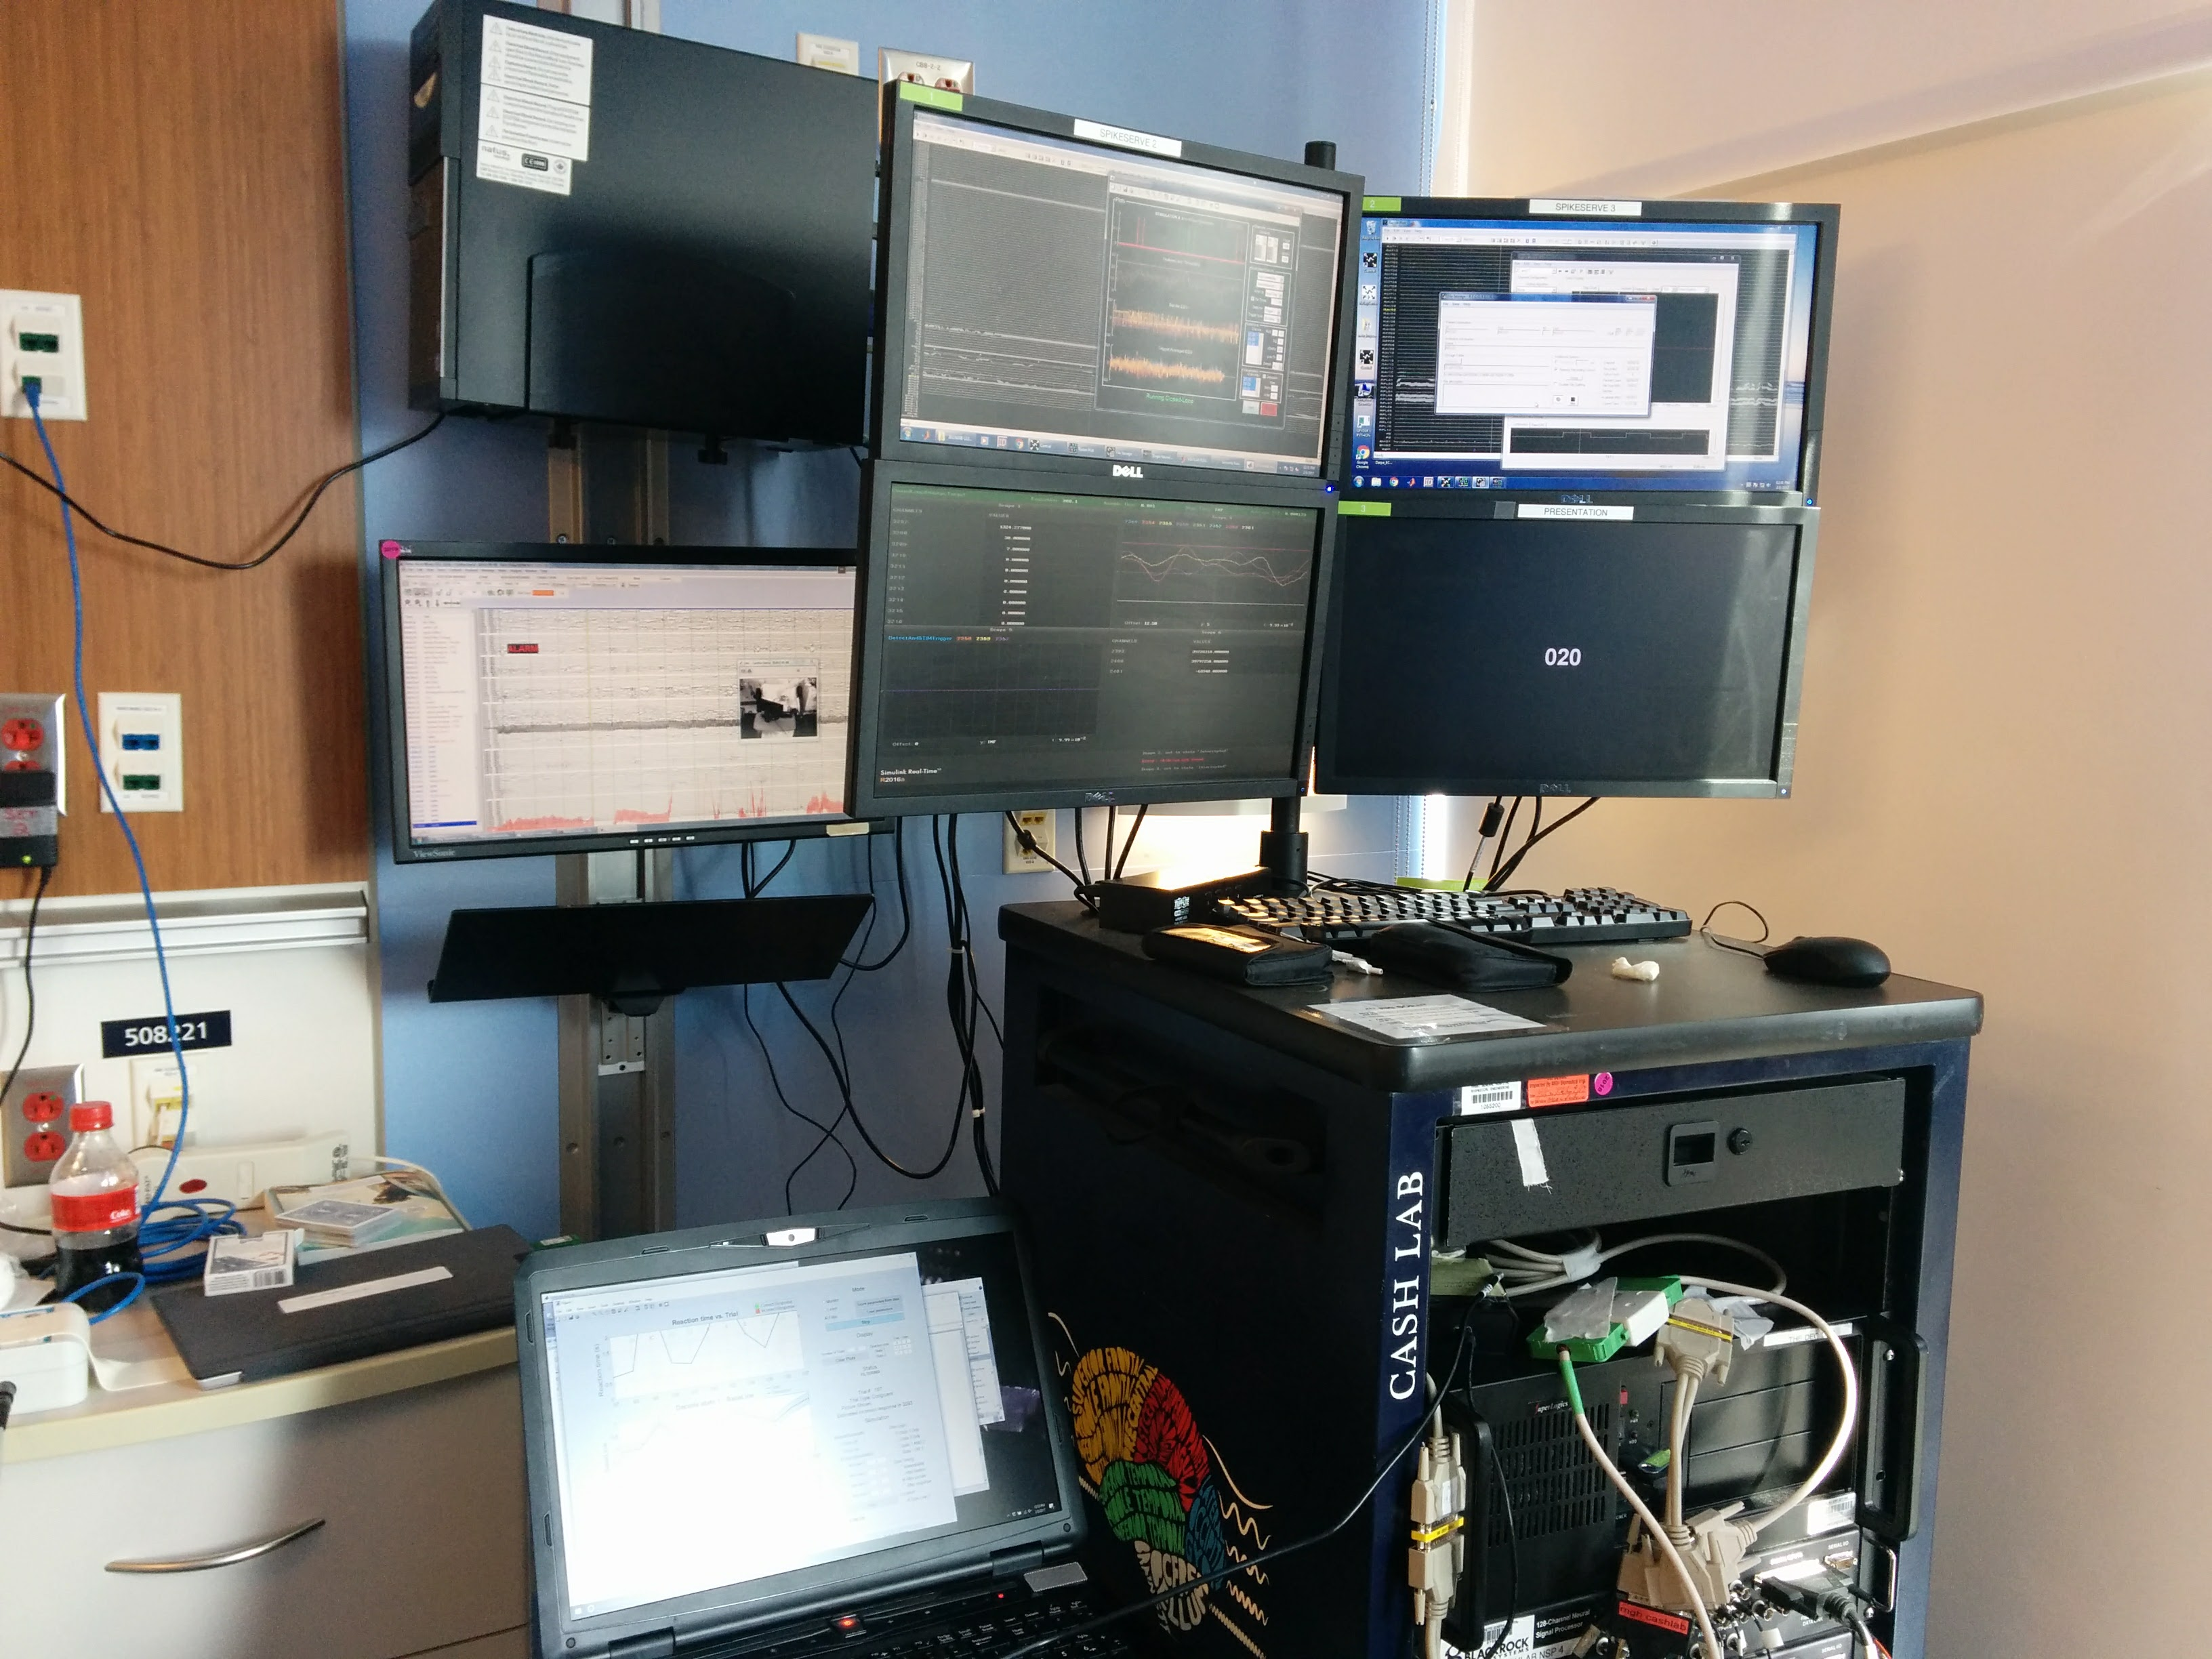
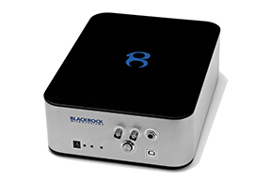
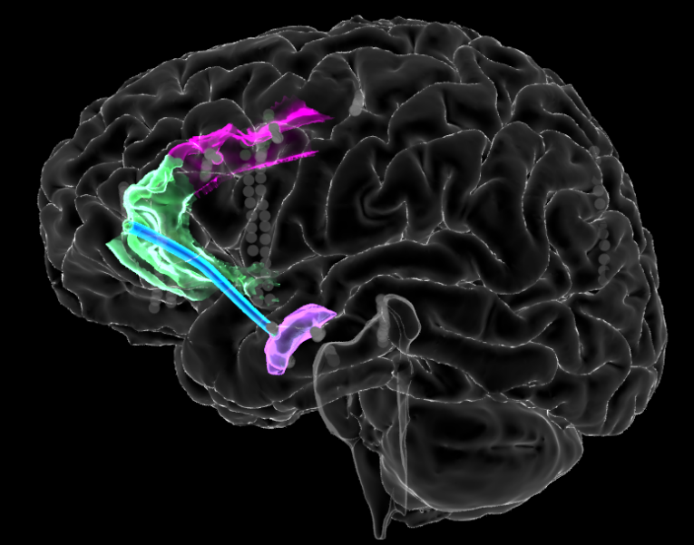
Closed-Loop Hardware Strategy
Neural Acquisition
Closed-loop Physiology
Neuronal Data
GUI (host)
Decider (target)
Stimulate
Patient
dACC stimulation
Tasks
020
rACC-Amygdala
theta band coherence,
Schematic of closed-loop experiments using rack-mounted hardware.
Notes:
This is the experimental setup: multiple independent boxes/rigs coupled together through a set of one-off interfaces.
The key point is that the same stimulator, coupled to the same electrodes in the patient, can be controlled
directly by the task (stimulation linked to presentation of task cues and responses),
by a real-time estimation of our hidden state variables, or
by real-time estimation of a neurophysiologic variable.
Today we’re showing you (1) and (3).

Slide 5
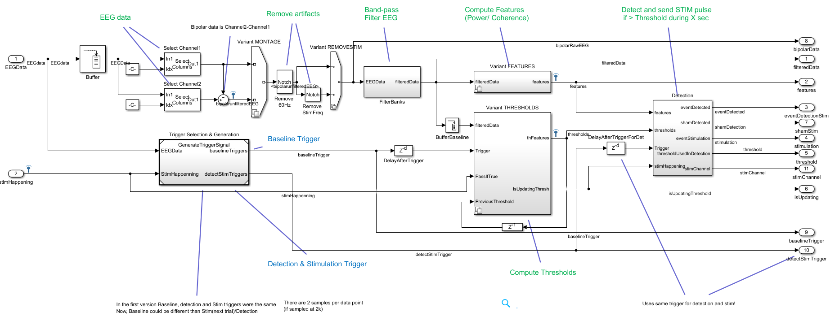
Closed Loop to Physiology Diagram

Slide 6
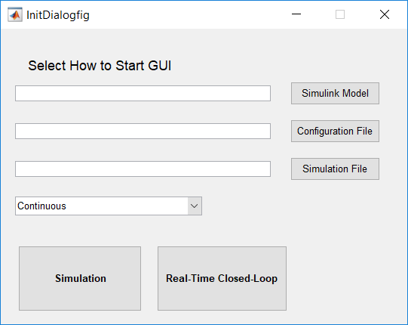
How to run CLoSES–RT: Real-Time tests in the EMU
Turn on CLoSES-RT target computer (USB should be connected – see SOP)
In MATLAB 2016b run runClosedLoopPhysiology.m or type: GUIClosedLoopConsole('PatientName',NAME)
On Initialization screen select:
Simulink model from CompileFile folder
Configuration file
Type of experiment = Continuous
Press Real-Time Closed-loop
to open main GUI

Slide 7
How to run CLoSES–RT: Simulations
Everything runs on same Windows computer
In MATLAB 2016b run runClosedLoopPhysiology.m or type: GUIClosedLoopConsole('PatientName',NAME)
On Initialization screen select:
Configuration file
Simulation file (created from previous tests – if empty: sine+rand)
Type of experiment = Continuous
Press Simulation to open main GUI

Slide 8
Simulation input
Possible inputs:
Random noise + sine (if simulation text is left empty)
MATLAB variable (MAT file)
Scripts to generate MAT (in folder Parameters):
script_createSimDataFromNEVfile.m
script_createSimDataFromPlexonFiles.m

Slide 9
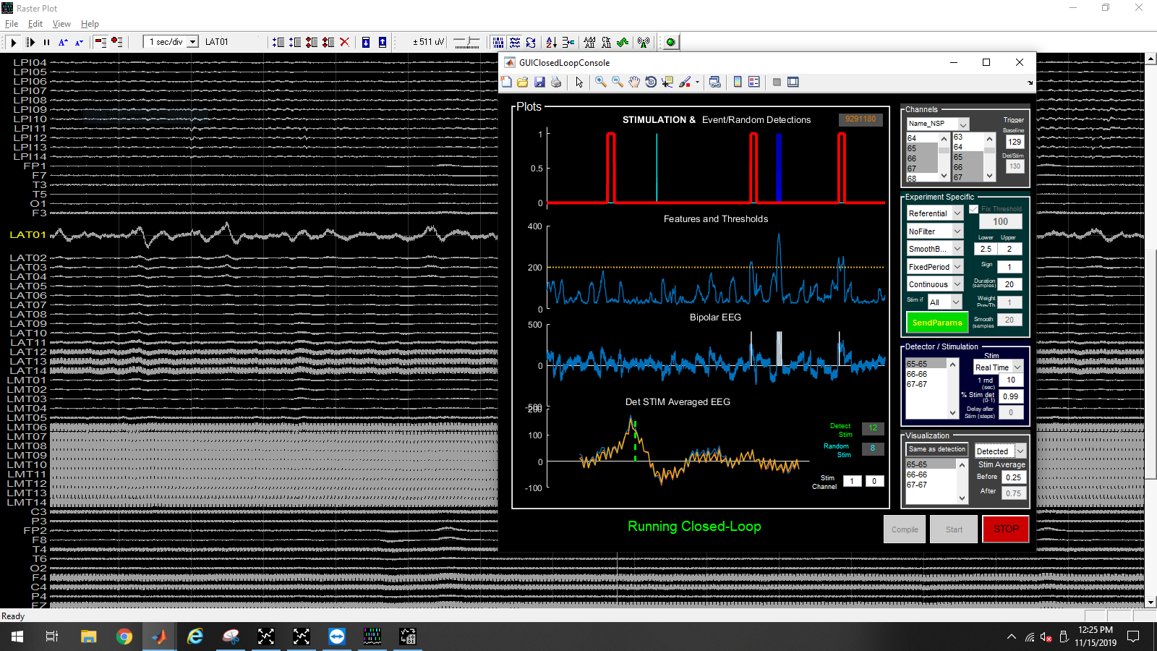
GUI
Example of CLoSES-RT running in the EMU during IIDs detection
Notes:
Example of simulated data generated from patient running MSIT
Details:
- Contacts are selected to create bipolar channels
- Stimulation happens on following trial
- Detection happens if ANY feature is > Threshold
- Threshold is updated in each trial based on signal 0.5sec before trigger (Trigger: EEGData)

Slide 10
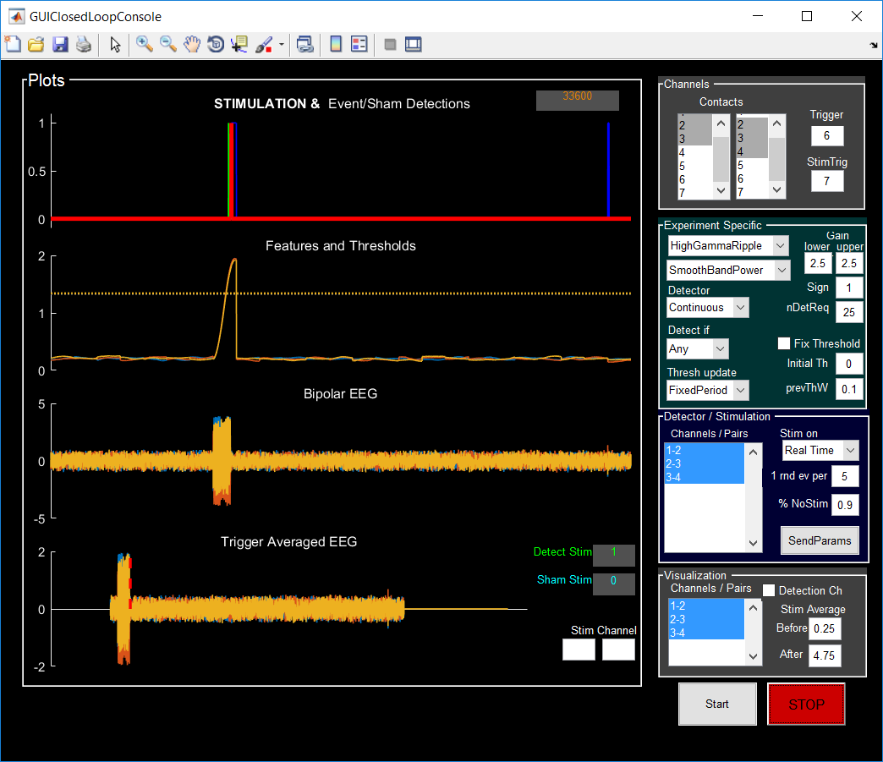
GUI
Example of simulation using sine+random
Notes:
Quick video capture on how to use it

Slide 11
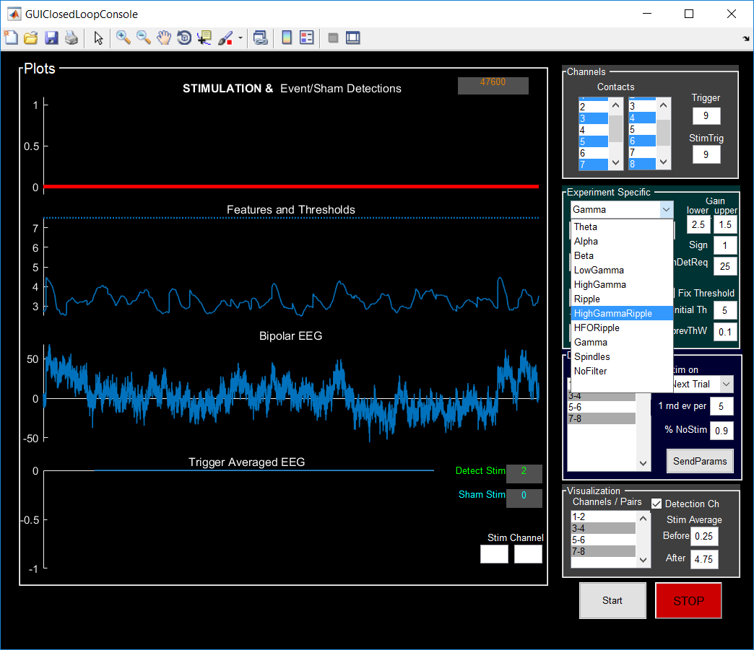
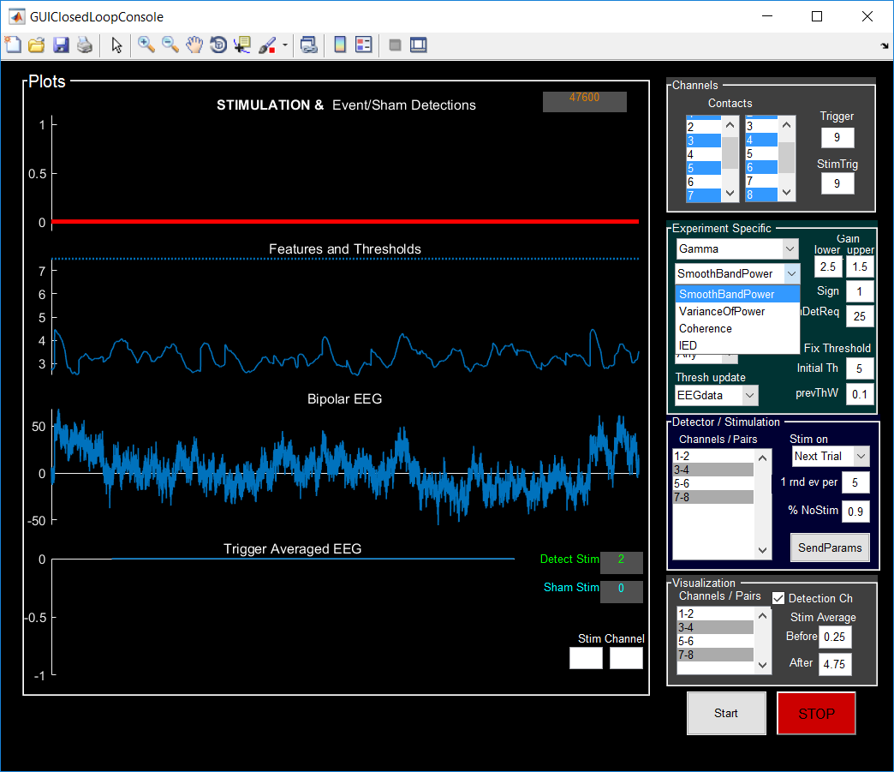
Decoding/Detection Methods
Provide stimulation if feature at a particular frequency band is above (below) threshold for a specified duration.
Implemented features:
Power and coherence
Various frequency bands.
Examples:
ECR / Movies: Theta coherence
MSIT: HighGammaRipple smooth power
Spikes : no-filter smooth power
Sleep: Alpha (or spindles) smooth power
Frequency Bands
Features

Slide 12
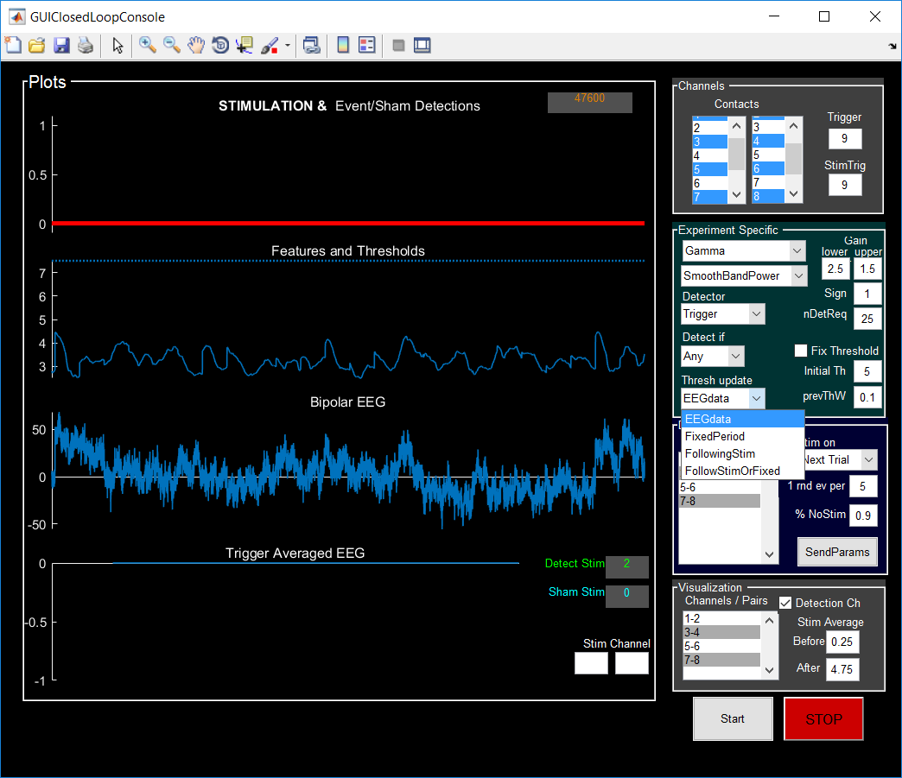
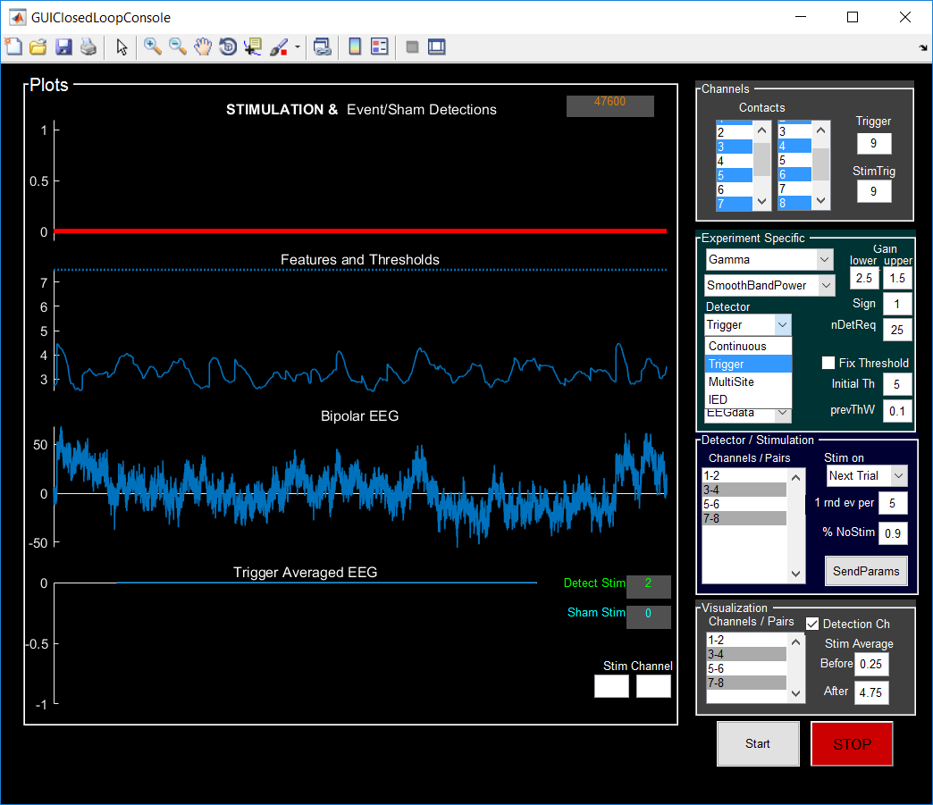
Detection Methods: Thresholds
Thresholds update
Fixed (check on Fix Threshold and value is Initial Th)
Based on triggers - EEGdata (e.g. before each trial)
Periodically - FixedPeriod
After N stimulations – FollowingStim
After N stimulations or after X sec without stim - FollowingStimOrFixed
Thresholds update
Detector Type

Slide 13
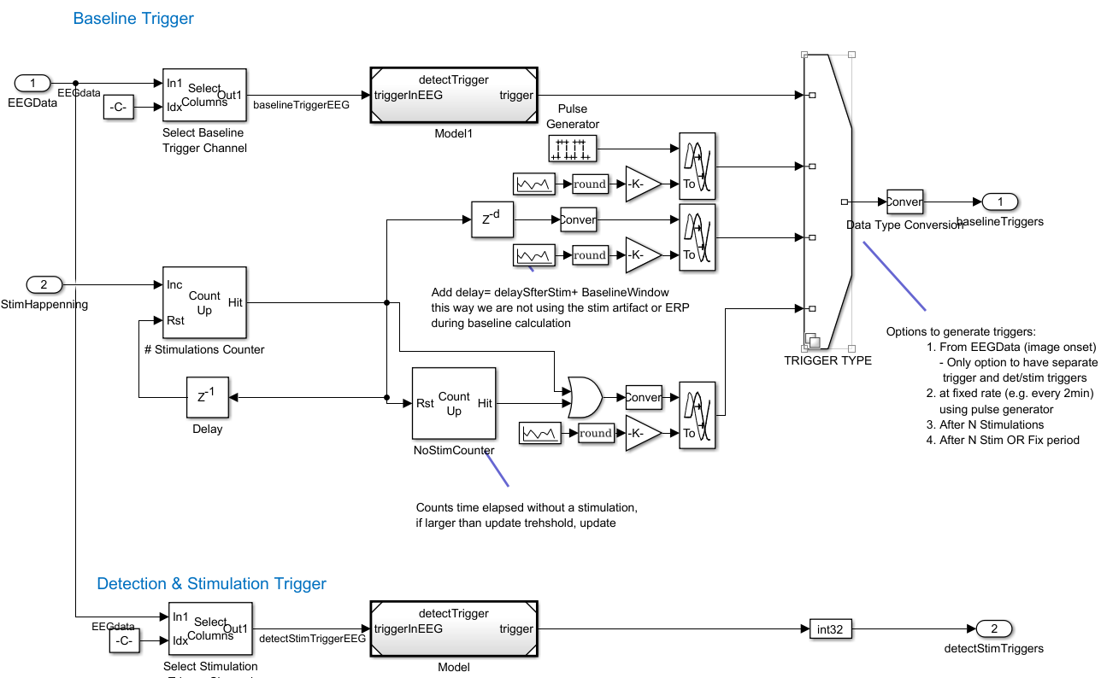
Threshold update modes
Thresholds update

Slide 14
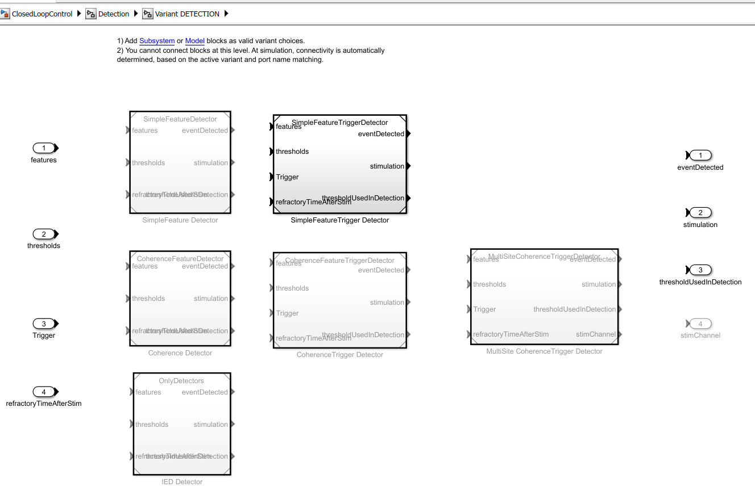
Detection Methods: Detectors
Detector Type

Slide 15
Stimulation
Stimulation could be sent
in real time,
at a trigger (e.g. next trial).
with fix delay (for both)
Stimulation output is a TTL pulse
It is also possible to modify Cerestim configuration (e.g. for MultiSite) but this occurs on the host.
Additional outputs on parallel port:
Detected event
Random event
Channels to Stim (in case of Multi-Site)

Slide 16
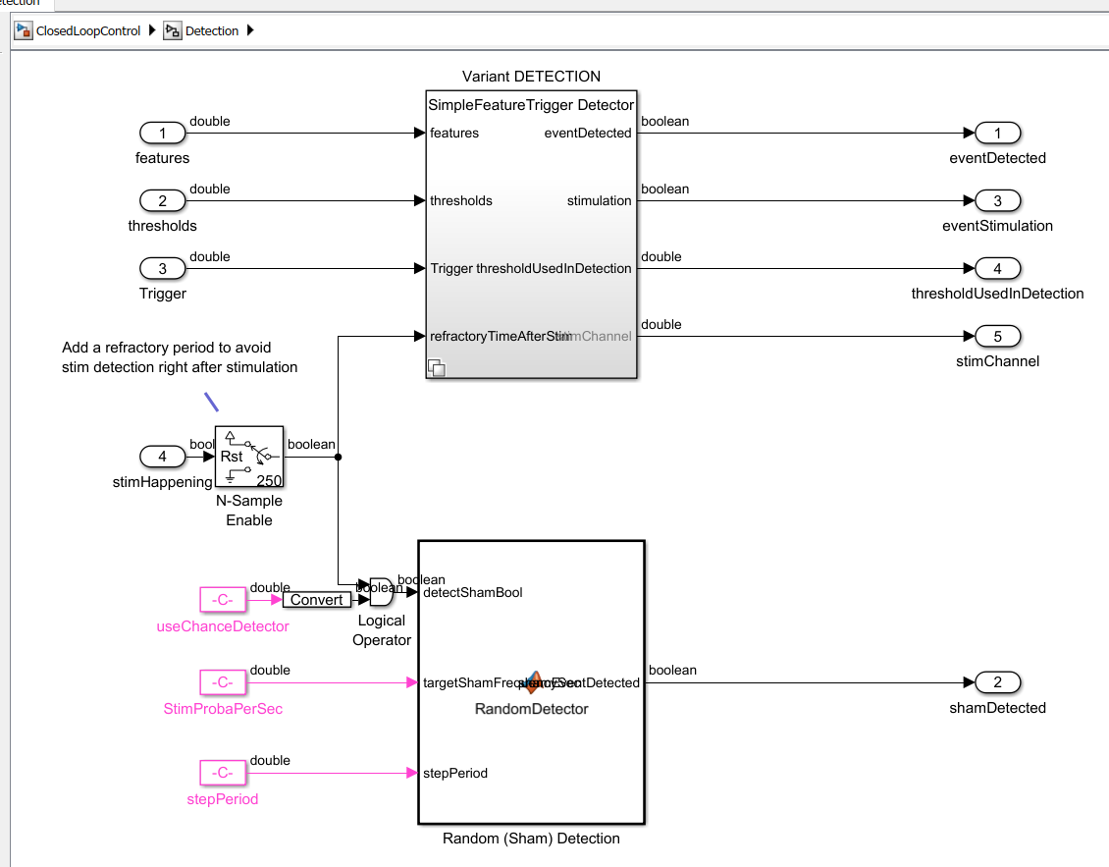
Detected vs. Random Stimulation

Slide 17
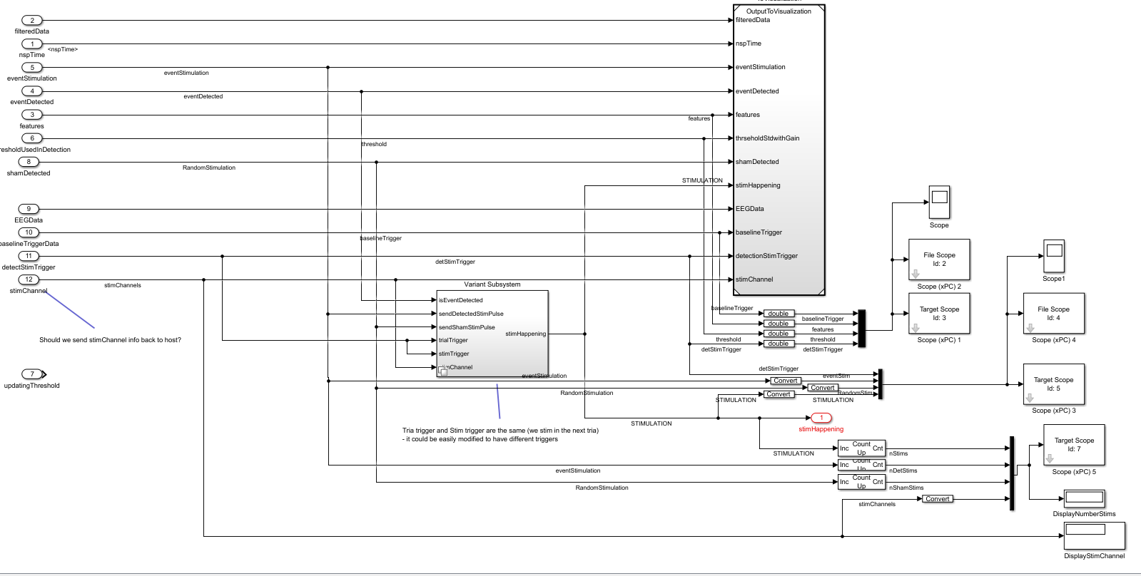
Outputs
To host
(GUI)
Output to Stimulator (TTL)
In decider computer

Slide 18
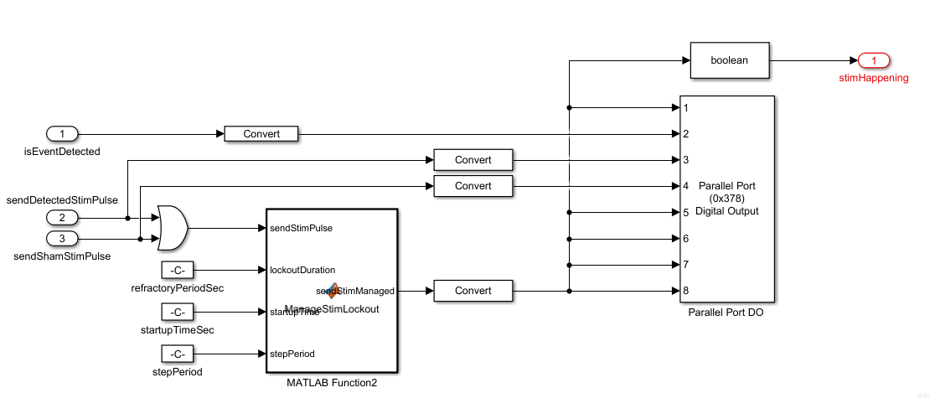
Output to Stimulator (TTL)

Slide 19
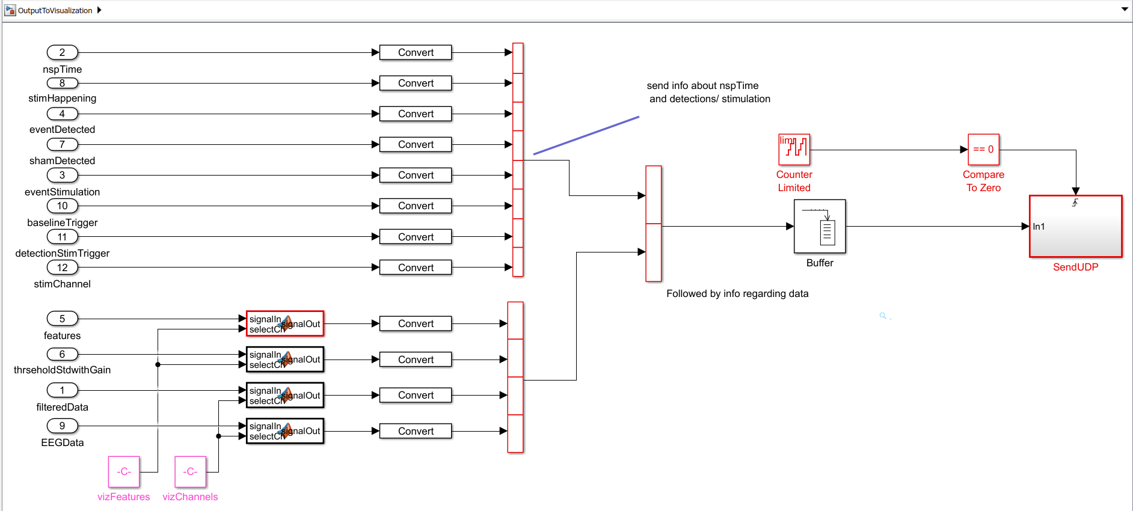
Output to Visualization
Visualization information is sent through UDP (crossover cable)
to host computer (e.g. spikewave 2)

Slide 20
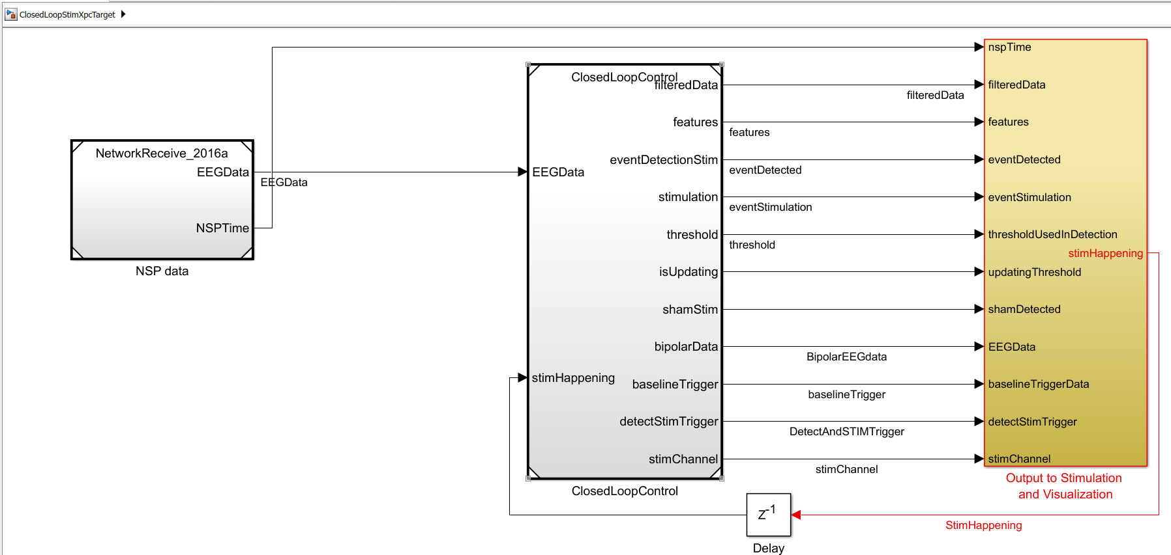
Models for different Inputs
ClosedLoopStimXpcTarget: Input from BlackRock through UDP
(Ethernet network connection)

Slide 21
ClosedLoopStimXpcTarget
Input from NSP1 corresponds to contacts: 1-200
Input from NSP2 corresponds to contacts: 201-400
Triggers:
Ainp1 (sync) = 129
Ainp2 (trigToStim) = 130
Ainp3 (ImageOnset) = 131

Slide 22
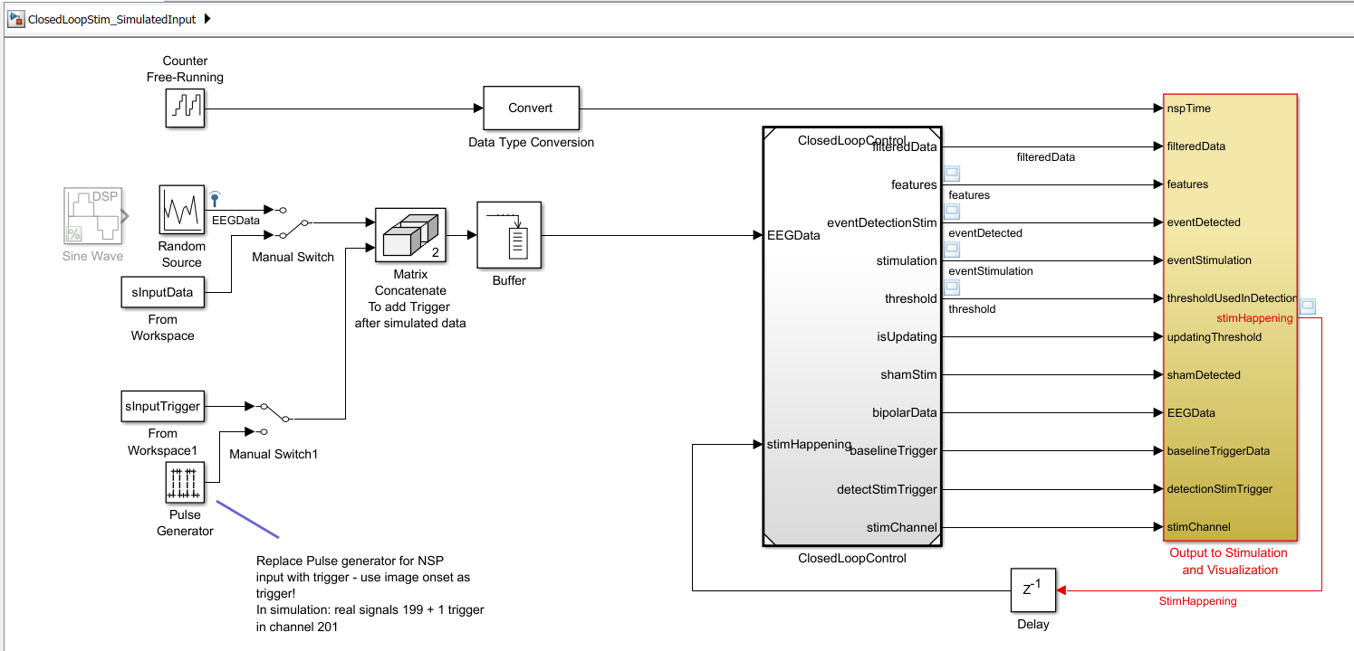
Models for different Inputs: Simulations
ClosedLoopStim_SimulatedInput: everything runs on your computer.
Possible inputs: random noise or Matlab variable

Slide 23
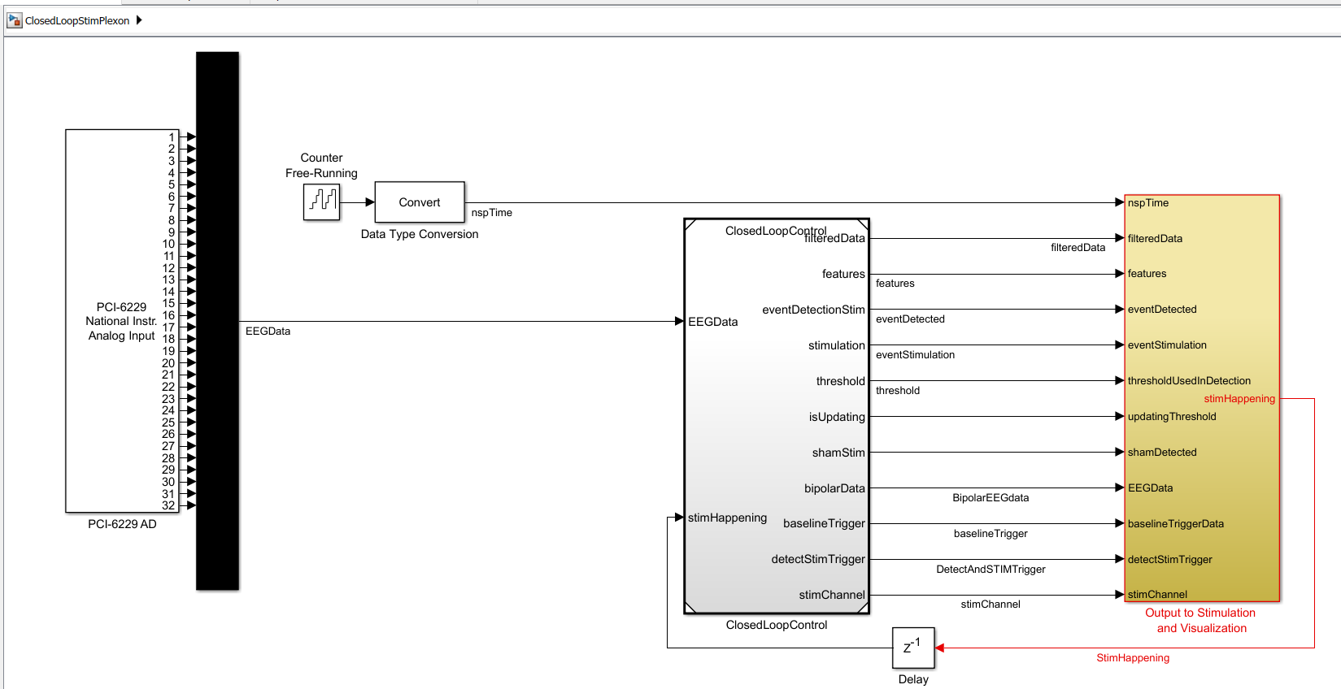
Blocks for different Inputs: Real Time Plexon
ClosedLoopStimPlexon: Input from Analog Input through
National Instrument PCI board (No time information!)

Slide 24
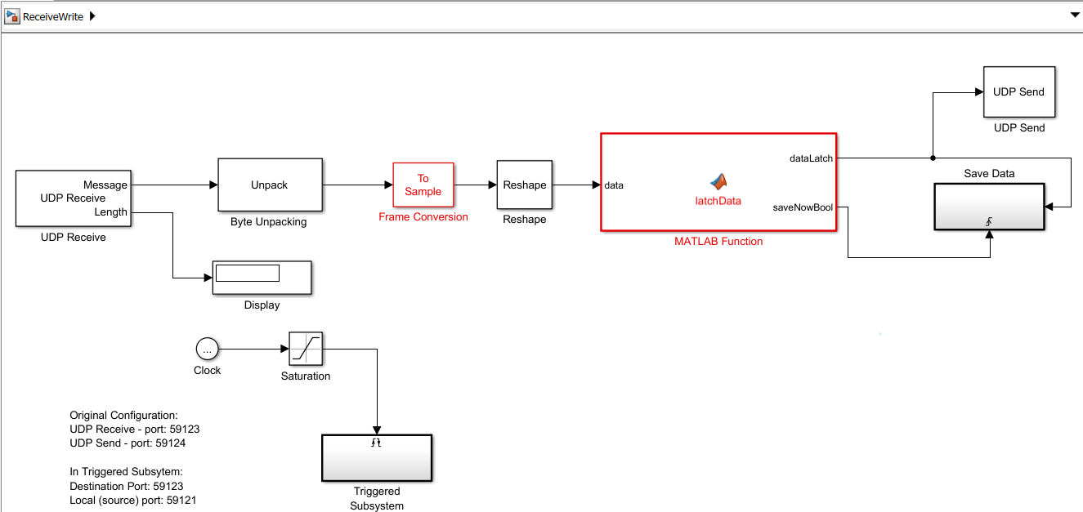
Model to Visualize and Save data
To GUI
From CLoSES-RT target
Save Data
This Runs on host computer
(where GUI is)

Slide 25
GUI Configuration
CLoSES-RT

Slide 26
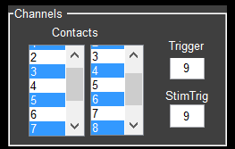
Configuration Parameters - GUI parameters
Contacts: left column is first contact of bipolar channel. Right column is second contact of bipolar channel.
Bipolar channel = # left col - # right col
NOTE: NSP2 contacts are 201 and above
Trigger: contact # of baseline trigger
Image onset for real time (default 131 – ainp3);
one before last for simulation
StimTrig: contact # of stimulation/detection trigger
usually same as Baseline Trigger
Notes:
Information on various parameters – what they mean what values make sense

Slide 27
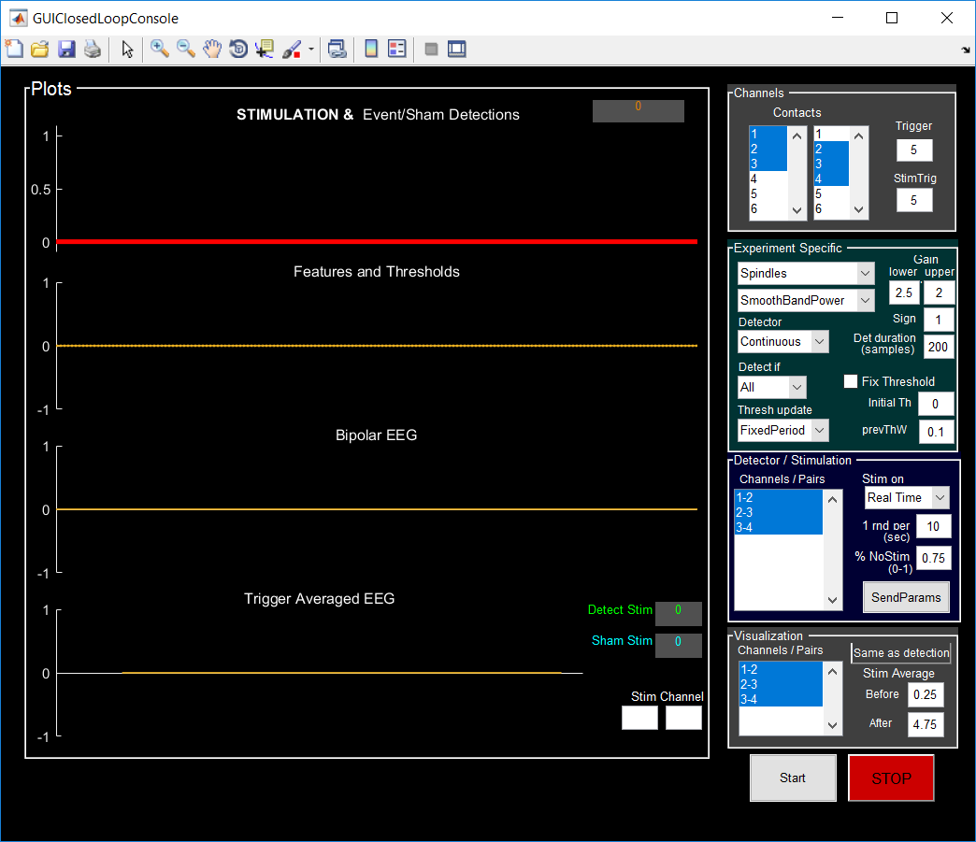
Configuration Parameters - GUI parameters
Detect if signal > (<) Gain Upper x Threshold for Detection
Gain:
Upper: numbers of times above (below) threshold – only gain used on one site stim.
Lower: ONLY used for MultiSite cases. In this case: Upper is above threshold, Lower is below threshold.
Sign:
+1 -> above threshold
-1 -> below threshold
Det. Duration:
in SAMPLES
detection occurs if signal is above (below) threshold for # of samples.
Notes:
Information on various parameters – what they mean what values make sense

Slide 28
Configuration Parameters - GUI parameters
Detect if signal > (<) Gain Upper x Threshold for Detection
Fix Threshold:
If checked, threshold detection is FIXED to value specified on Initial Th (times Gain Upper) and prevThW is changed to 1.
If unchecked, threshold is computed according to Thresh update.
Initial Th: Initial Threshold
Initial Value of threshold (before being updated)
or FIXED value if Fix Threshold is checked
prevThW: previous thresholds weight
Threshold = prevThW x value previous Th + (1- prevThW) x value current th
prevThW =1 to have fixed threshold (in GUI: Fix Threshold is checked). Idea: only initial th matters, so the weight of current is zero.
Notes:
Information on various parameters – what they mean what values make sense

Slide 29
Configuration Parameters - GUI parameters
Detector / Stimulation
Channels / Pairs:
Select in which channels or pairs (for coherence) the detection actually occurs.
Stimulation could be on real-time or on next trial
1 rnd per XX sec: 1 random event per specified seconds
a “random stim pulse is sent if rand value (drawn from a uniform random distribution) is <
% Stim det: how many of the detected events would trigger stimulation (between 0-1)
Notes:
Information on various parameters – what they mean what values make sense

Slide 30
Configuration Parameters - GUI parameters
Visualization
Channels / Pairs:
Select which channels or pairs to visualize.
Same as detection:
if clicked, channels/pairs take the values of the detection channels/pairs.
Stim Average:
Before: time before stimulation in averaged plot (in second)
After: time after stimulation in averaged plot (in second). Before + after is always < 5sec
Notes:
Information on various parameters – what they mean what values make sense

Slide 31
Configuration Parameters - GUI parameters
Starts: starts model.
If in rig the first time or each time a combo is changed (filters, features, etc) it will compile (takes about 1 minute).
Stop: when stop is clicked data is saved in dirResults directory (default C:\Temp).
File format: SessionData_PATIENTNAME_DATE_TIME.mat
Notes:
Information on various parameters – what they mean what values make sense

Slide 32
Configuration Parameters - Other parameters
Only the most common parameters can be modified on the GUI. Other parameters can be configured on Configuration files.
For detailed information of each parameter look at the different config files or at InitCoreParams.m in folder Parameters
Notes:
Information on various parameters – what they mean what values make sense

